Slide 1
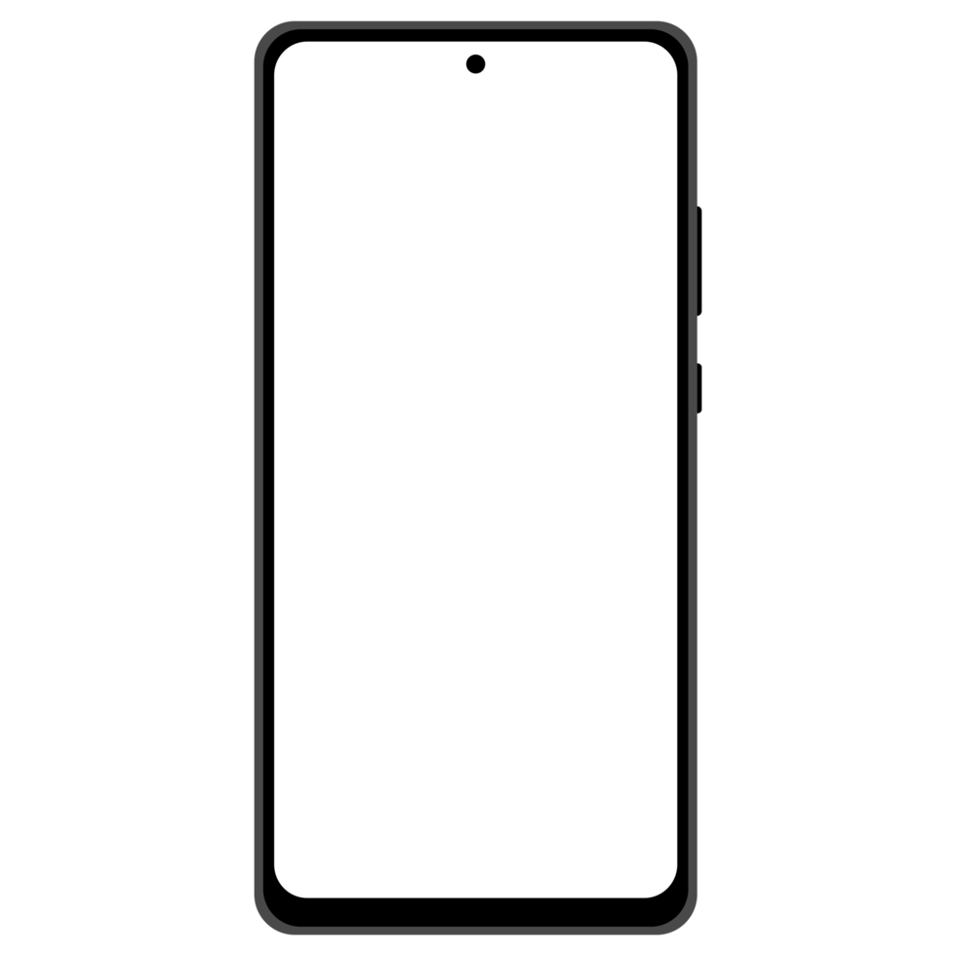
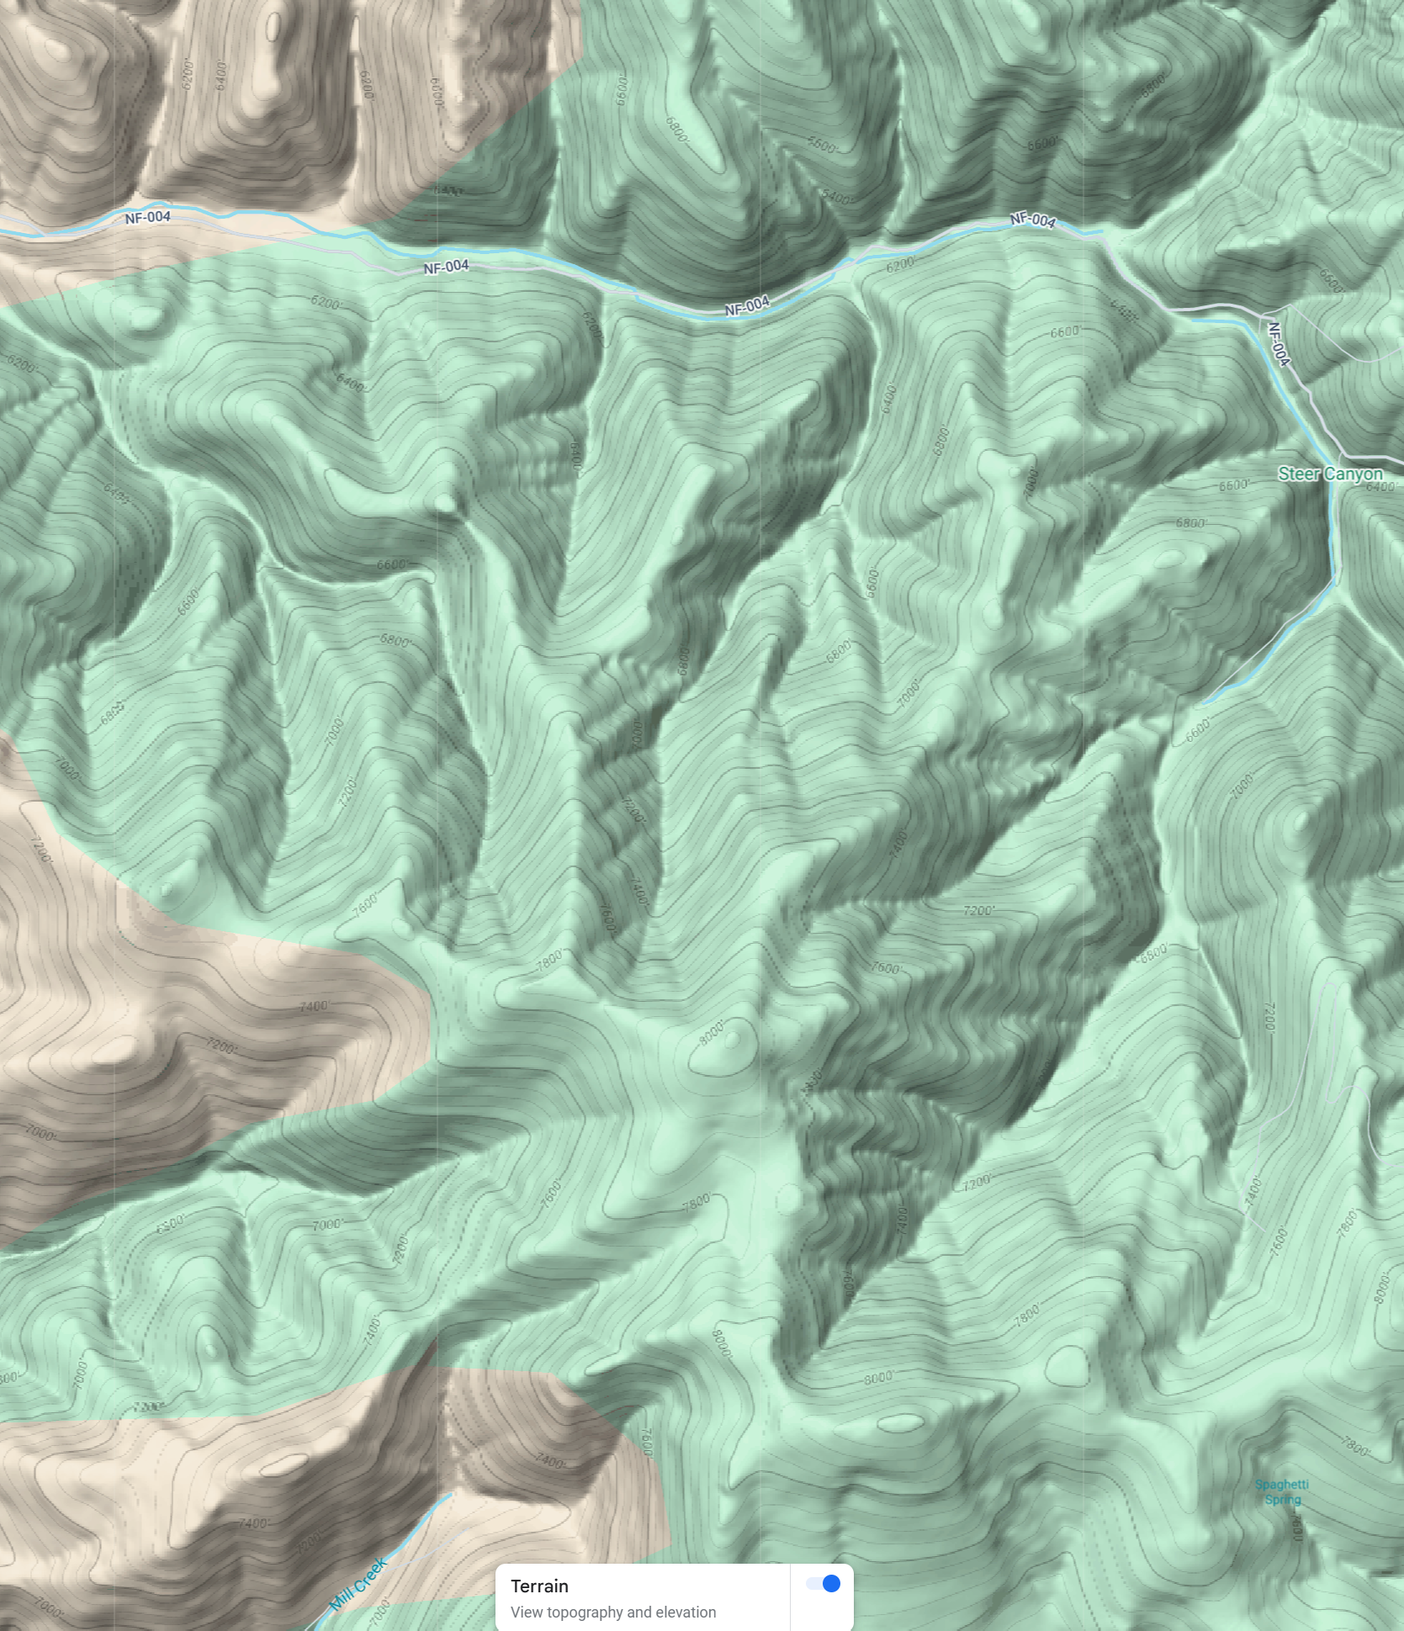
Overall goal is to display the GPS coordinates on a map (different maps should be available and we can discus a strategy for this) with the corresponding ID and altitude. The ID and altitude will be displayed only when the dot is clicked (this will prevent too much data on the screen at once)
ID number 55.6 m
Please use a native map in the Iphone (which can be downloaded) in which the different TX boards will displayed. Let’s make sure that the map can be zoomable and panning along the map is allowed
Is there a way to display the location of the phone on the map with a blue dot (like google maps does)? This would help to orientate

Slide 2
App structure
Map with the GNSS location of TX Boards
Settings (here we can switch between different maps and establish connection with Base Station)
1) Master Data export
2) Bluetooth status/settings
User should be able to export into txt file (or CSV or other file type) all the data stored in the app with TX Board ID, date location and altitude
This is where we can discuss the data structure. I strongly suggest Object oriented.
We could reduce the volume of data retained.
3) Current DATE for map display
1 2
1 2
The date can be changed to see the different TX boards along time

Slide 3
import React, { useEffect, useState } from 'react';
import { View, PermissionsAndroid, Platform, Alert } from 'react-native';
import { BleManager } from 'react-native-ble-plx';
import MapView, { Marker } from 'react-native-maps';
import { Buffer } from 'buffer'; // If needed, install the 'buffer' package
const App = () => {
const [devices, setDevices] = useState([]);
const [region, setRegion] = useState({
latitude: 37.78825,
longitude: -122.4324,
latitudeDelta: 0.0922,
longitudeDelta: 0.0421,
});
const bleManager = new BleManager();
useEffect(() => {
const startScan = async () => {
// On Android, request location permissions necessary for Bluetooth scanning.
if (Platform.OS === 'android') {
const granted = await PermissionsAndroid.request(
PermissionsAndroid.PERMISSIONS.ACCESS_FINE_LOCATION,
{
title: 'Location Permission for Bluetooth',
message: 'This app needs access to your location to scan for Bluetooth devices.',
buttonNeutral: 'Ask Me Later',
buttonNegative: 'Cancel',
buttonPositive: 'OK',
}
);
if (granted !== PermissionsAndroid.RESULTS.GRANTED) {
Alert.alert('Location permission not granted');
return;
}
}
// Start scanning for devices.
bleManager.startDeviceScan(null, { allowDuplicates: false }, (error, device) => {
if (error) {
console.log('Scan error:', error);
return;
}
// Check if the device has manufacturer data (assumed to contain coordinates)
if (device && device.manufacturerData) {
try {
// Decode the base64 manufacturer data into a buffer.
const rawData = Buffer.from(device.manufacturerData, 'base64');
// Verify that there are at least 8 bytes (2 floats).
if (rawData.length >= 8) {
// Parse two little-endian floats from the buffer.
const lat = rawData.readFloatLE(0);
const lng = rawData.readFloatLE(4);
// Add this device to our state if it isn’t already present.
setDevices(prevDevices => {
if (!prevDevices.find(d => d.id === device.id)) {
return [...prevDevices, { id: device.id, latitude: lat, longitude: lng }];
}
return prevDevices;
});
}
} catch (parseError) {
console.log('Error parsing manufacturer data:', parseError);
}
}
});
};
startScan();
// Clean up on unmount.
return () => {
bleManager.stopDeviceScan();
bleManager.destroy();
};
}, []);
return (
<View style={{ flex: 1 }}>
<MapView
style={{ flex: 1 }}
region={region}
onRegionChangeComplete={region => setRegion(region)}
>
{devices.map(device => (
<Marker
key={device.id}
coordinate={{ latitude: device.latitude, longitude: device.longitude }}
title={device.id}
/>
))}
</MapView>
</View>
);
};
export default App;

